Slide 1

Divhacks 2023
By: Haolin Guo, Shuyan Chen

Slide 2
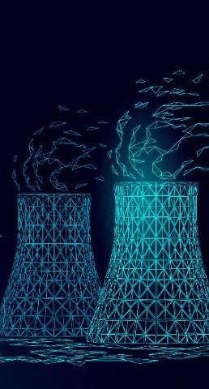
VoltVision: Mapping Tomorrow's Energy Footprint with Machine Learning
Track: AI/ML
Application: Green Tech / Environment
Technologies: Machine Learning (regressions), Data Analytics

Slide 3
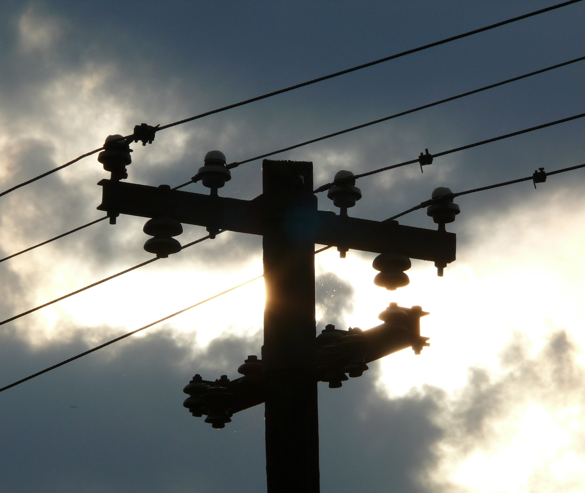
Background
High electricity consumption in U.S. households
Significant portion wasted daily
Wastage contributes to environmental harm and potential energy crises
Predicted rolling blackouts by 2040 if unchecked

Slide 4
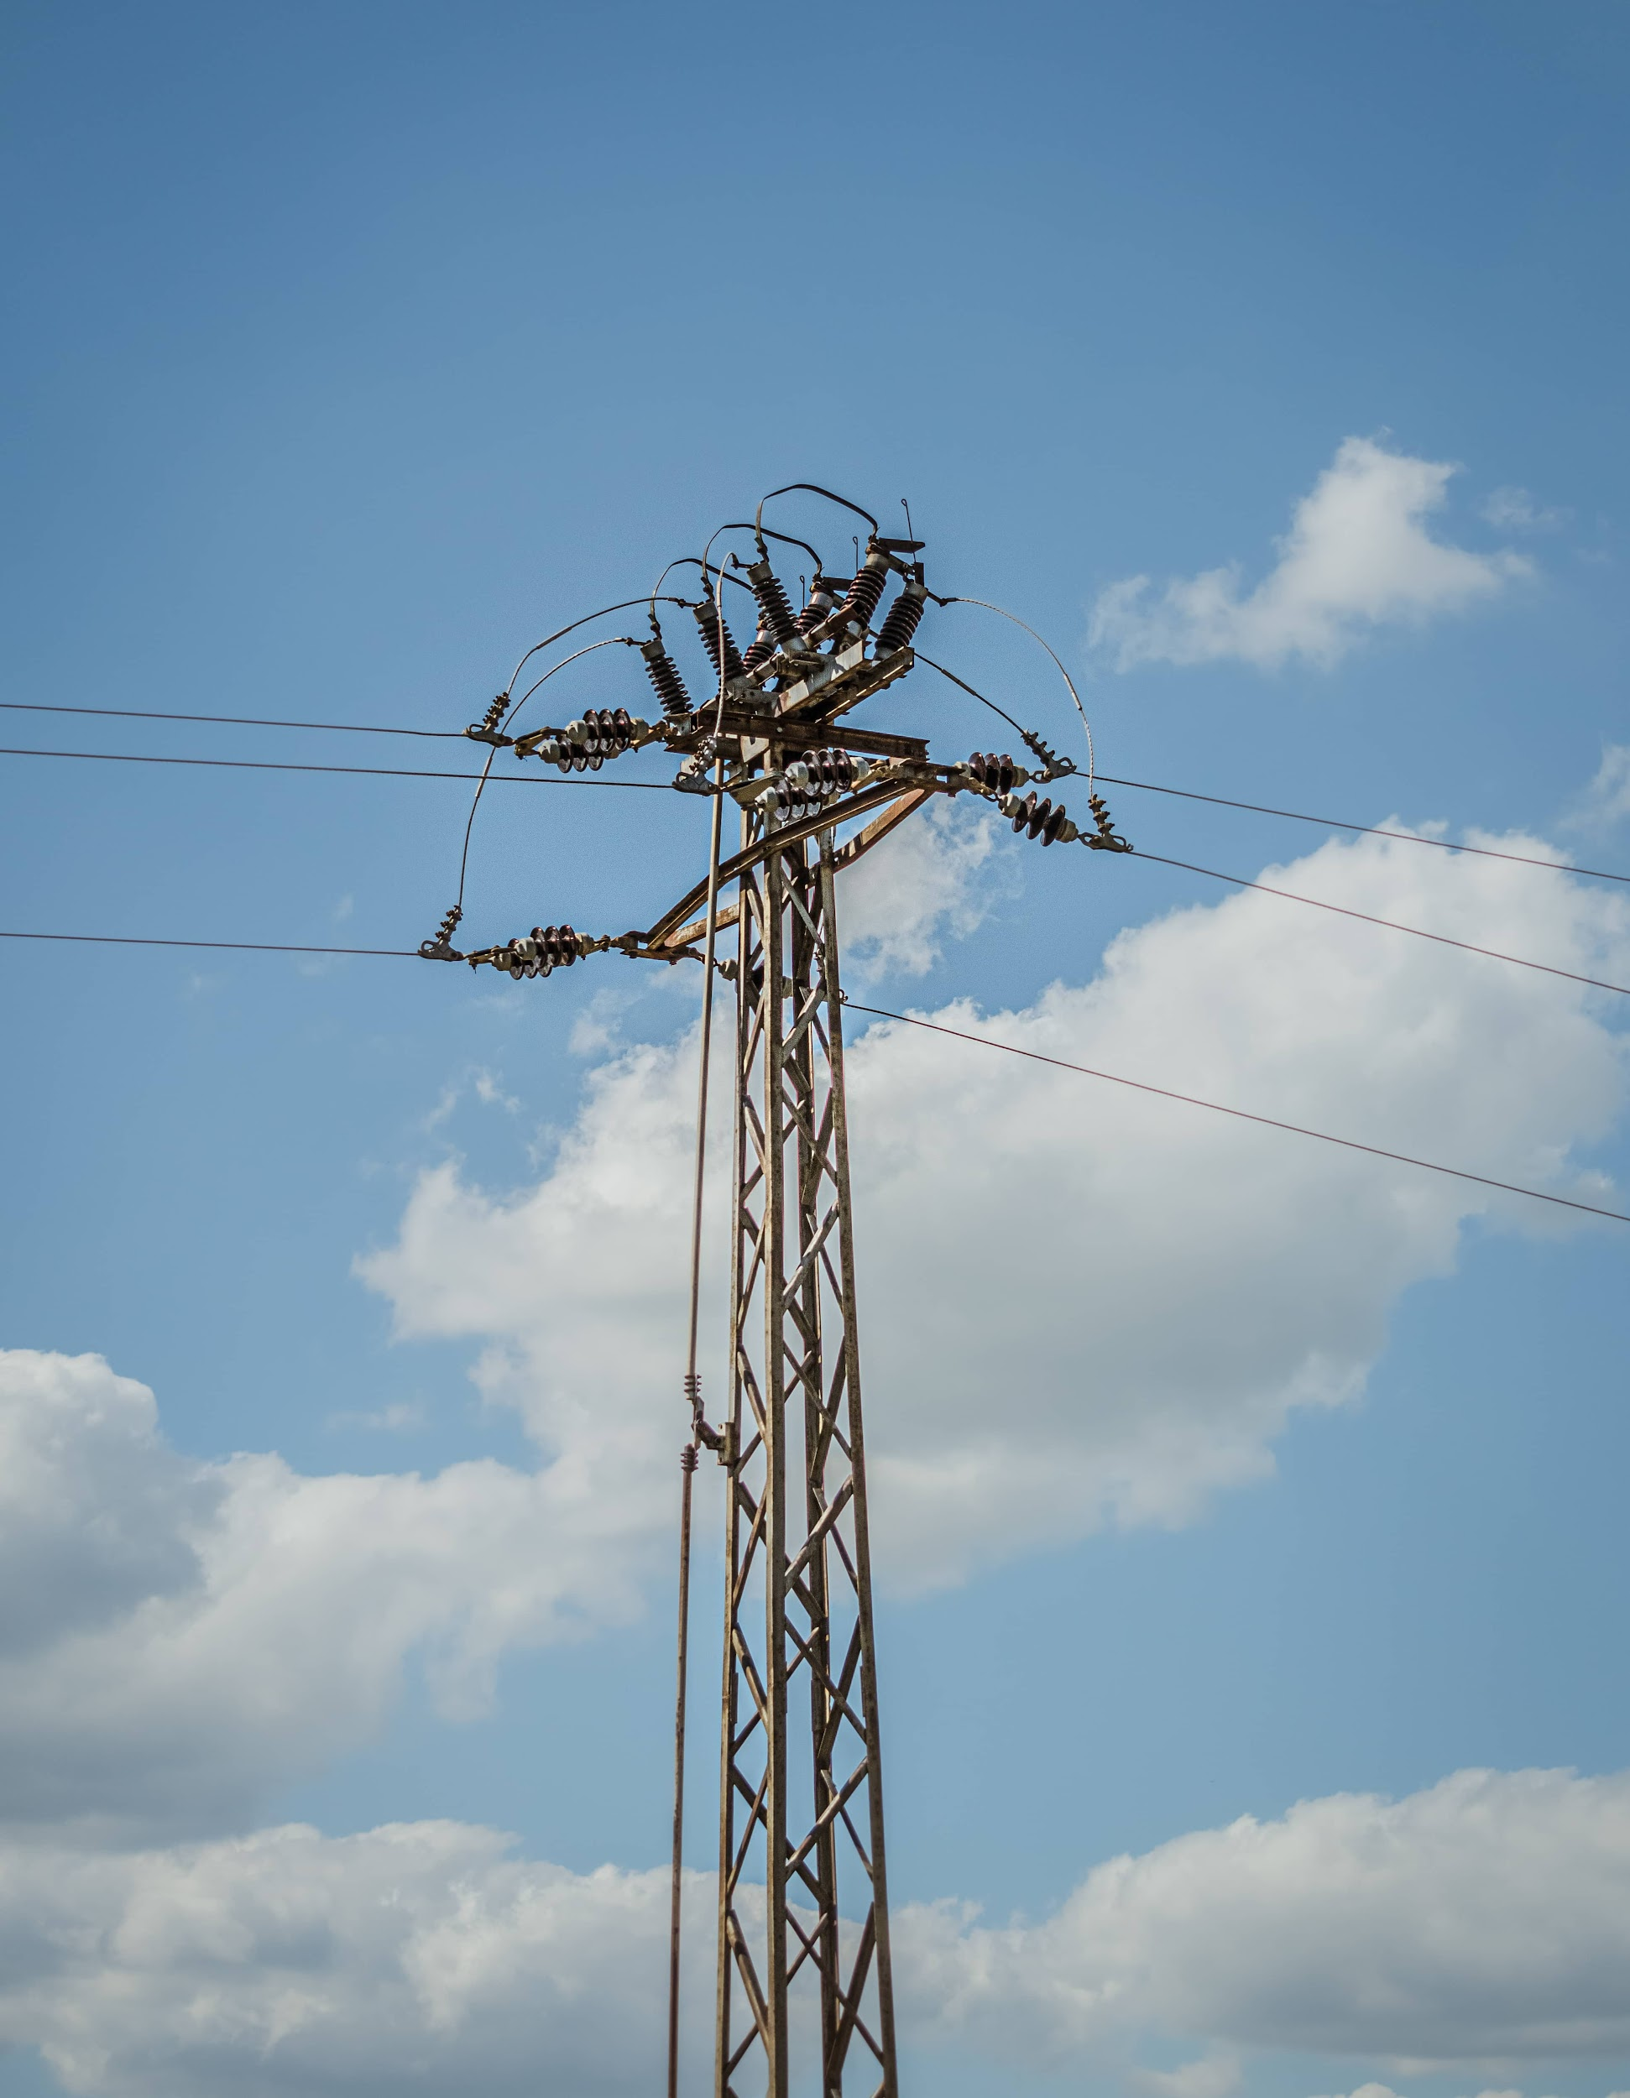
Benefits
Cost Savings
Crisis Prevention
Peak Usage Preparations

Slide 5
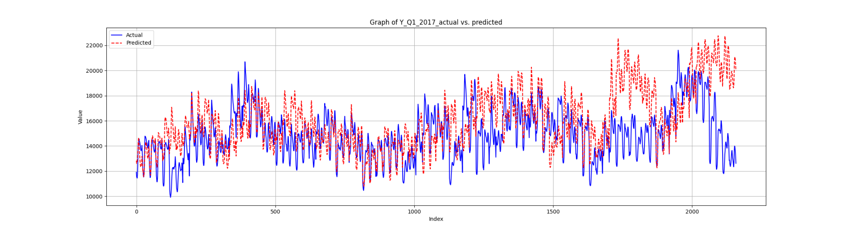
Implementation
Regression: using time vs. electricity usage
Didn’t work because of fluctuations

Slide 6
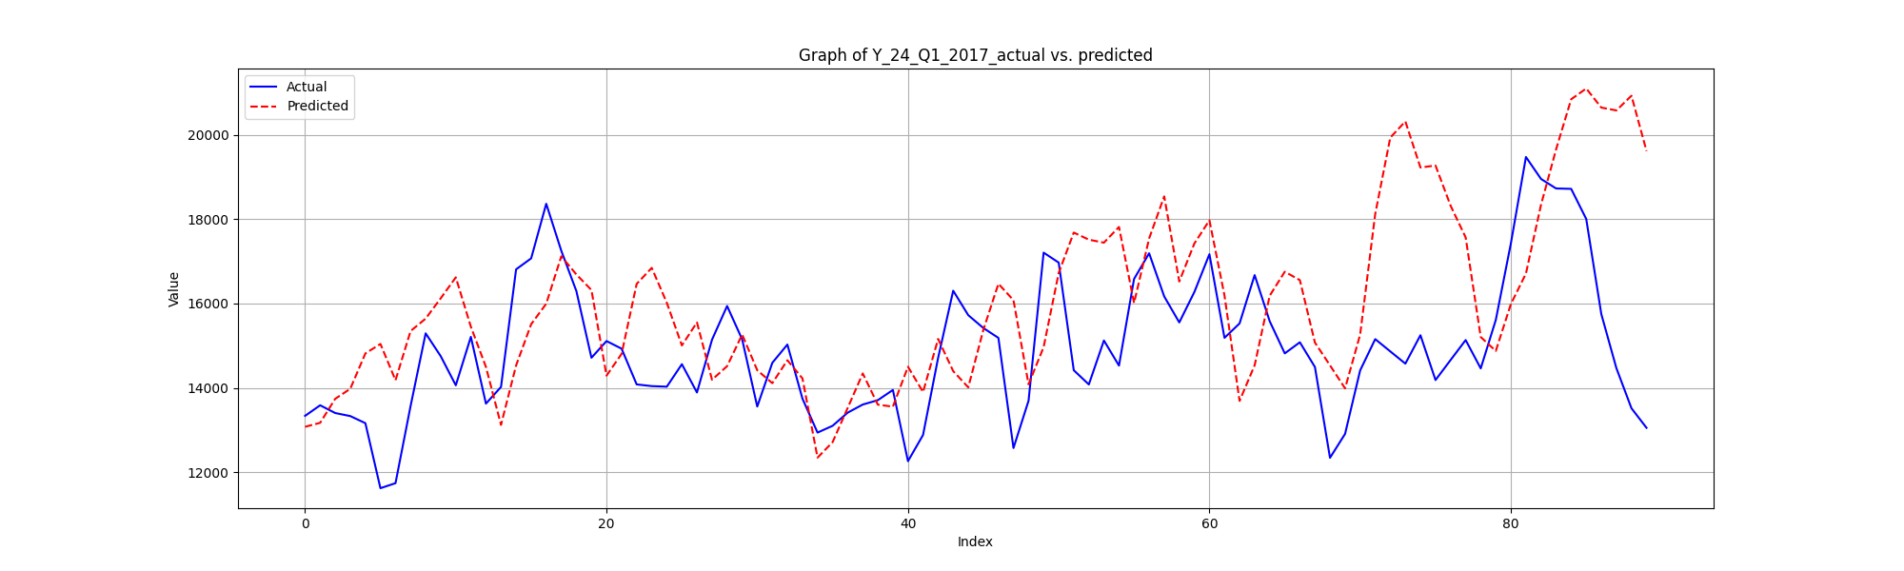
Implementation
Solution: Simple Moving Average over 24-hour periods
Improved, but not ideal

Slide 7
Implementation
Hyperparameter tuning: not ideal
Trying different models: not ideal

Slide 8
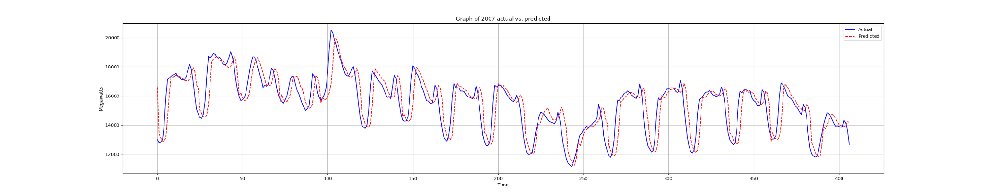
Implementation
Tried using 4d array as individual variables
X: [year, month, date, hour]
Y: [usage]

Slide 9
What we learned
The Importance of Data Processing
Notes:
The meticulous management and preprocessing of your dataset is paramount and holds equal significance to the selection of appropriate models and hyperparameters.

Slide 10
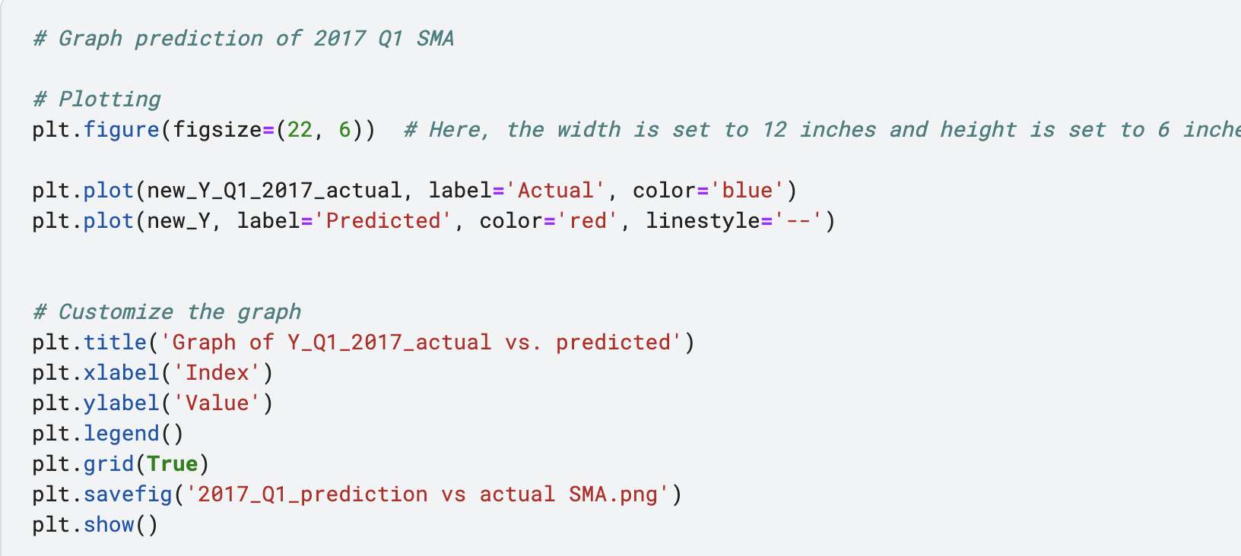
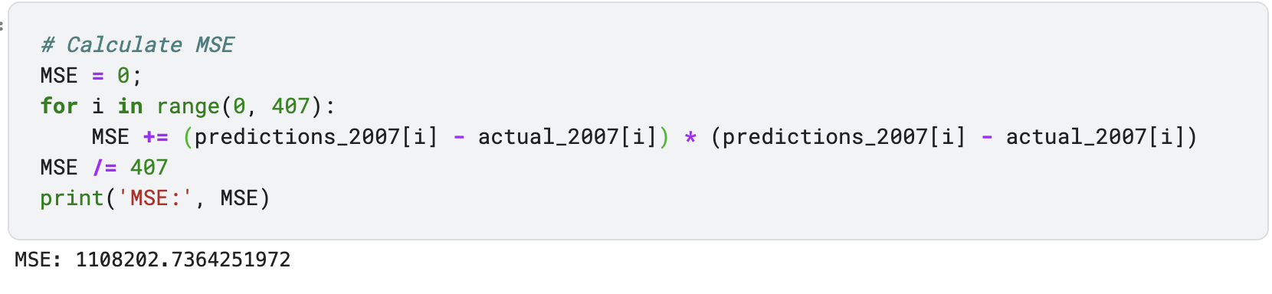
Code Snippets

Slide 11
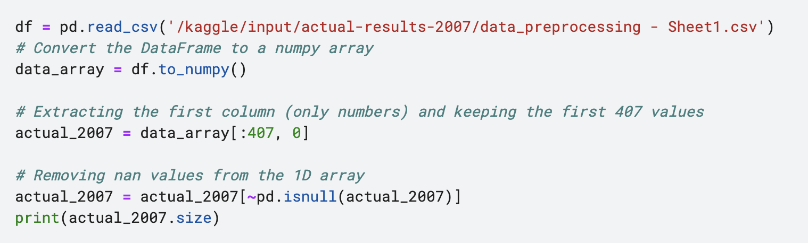
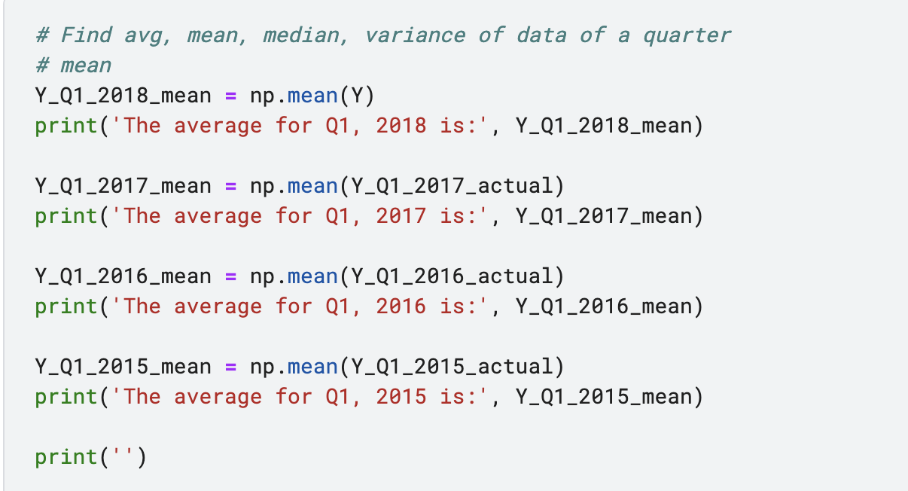
Code Snippets

